Slide 1
Data Discovery: Parser Project
Tripadvisor Restaurant Ratings

Slide 2
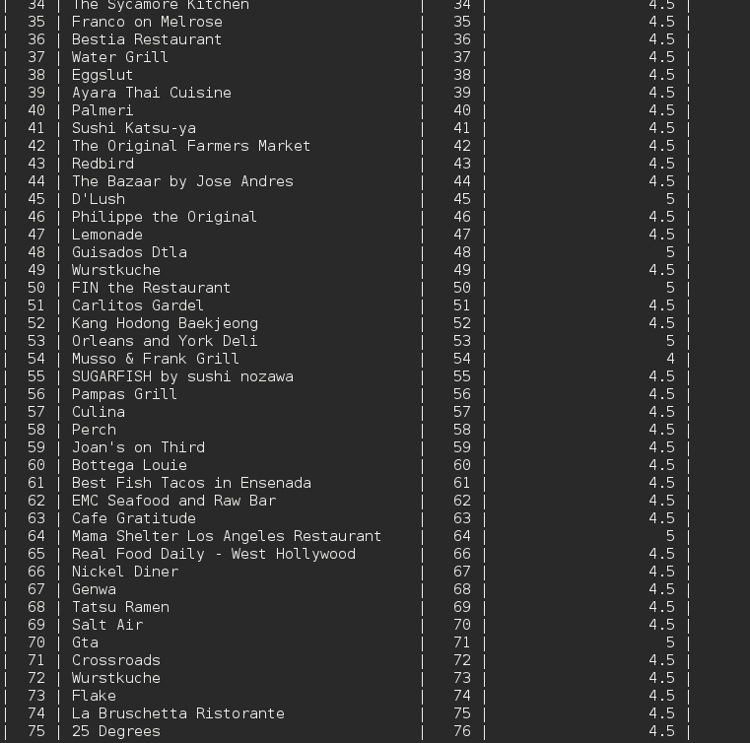
SELECT * FROM restaurant ORDER BY rank;
It seems that there is no relation between the average amount of stars a restaurant gets and the ranking it holds.
There is no restaurant ranked 65th

Slide 3

Variations in review per user
SELECT COUNT(user_id)
FROM (
SELECT user_id, COUNT(DISTINCT review_stars) ct
FROM review
GROUP BY user_id) c
WHERE ct > 1;
Our users seem to be creatures of habit:
Out of the 928 reviewers present in the data, only 31 of them have given out at least two different amounts of stars for their reviews.
In changing the number for the comparison, we find that no user has given out more than two amounts of stars for their reviews.
Perhaps our users are very lazy, or only ever visit restaurants that are pretty good.

Slide 4
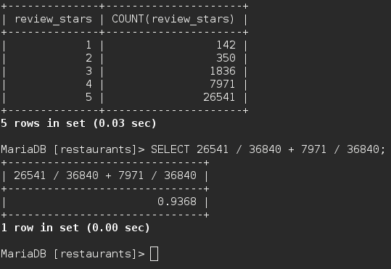
And this may be the case...
It seems that our users only eat at good restaurants.
93.68% of all reviews are at least 4 stars.
SELECT review_stars, COUNT(review_stars)
FROM review
GROUP BY review_stars;

